Slide 1
On the Frontlines: Current Biosecurity Work
Hamish Lass
Biosecurity Manager

Slide 2
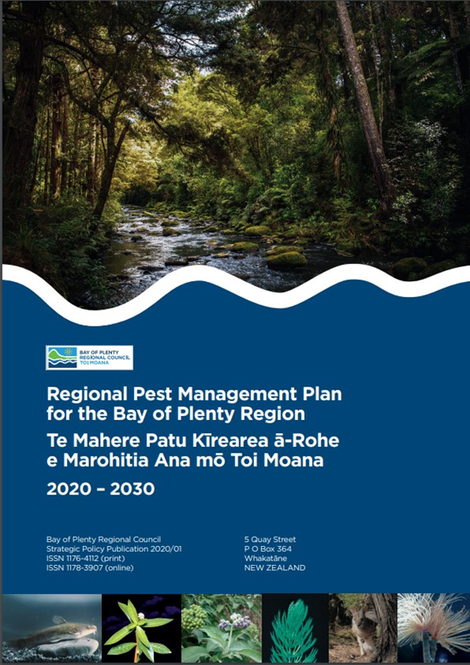
The Frontlines: Current Biosecurity Work
Biosecurity Importance
Biosecurity protects the environment, economy, and communities from pests and diseases in the Bay of Plenty region.
Frontline Biosecurity Actions
Key biosecurity activities include prevention, early detection, surveillance, response, and long-term management.
Collaboration and Community
BOPRC partners with landowners, iwi, communities, and agencies to share biosecurity responsibilities and protect taonga species.
Challenges and Future Directions
Current challenges in biosecurity include managing threats effectively and planning for sustainable future protection

Slide 3
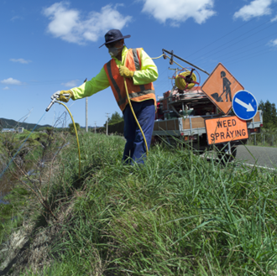
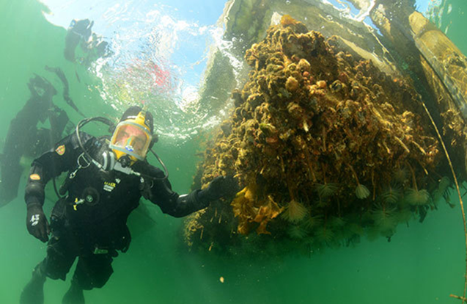
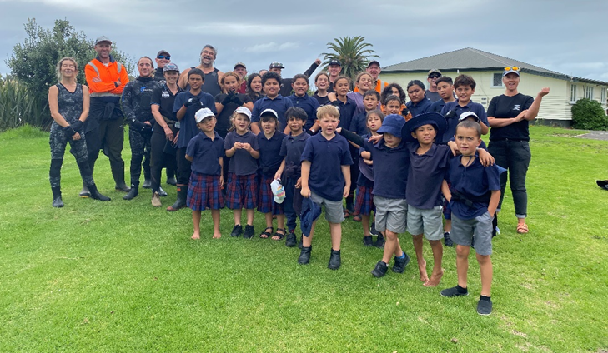
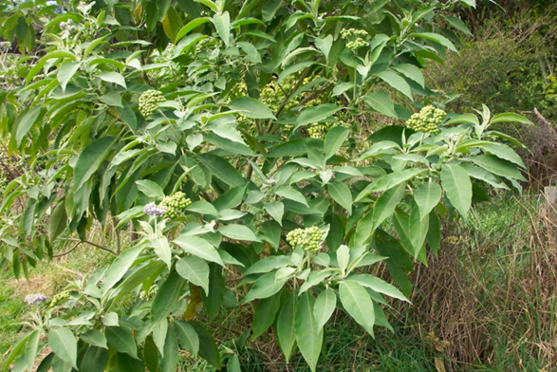
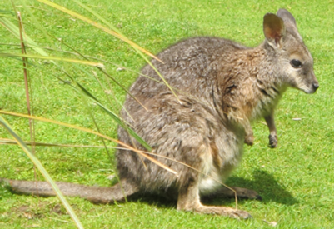
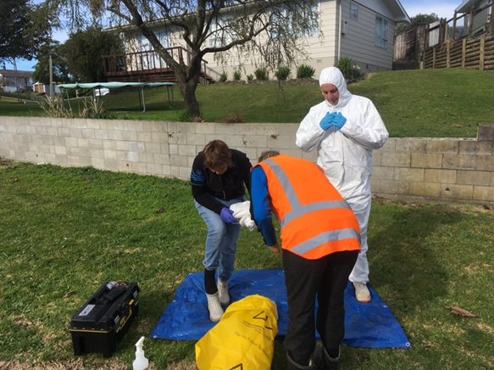
Protecting the Environment, Economy, and Communities
Environmental Protection
Biosecurity safeguards native biodiversity by preventing invasive species from harming forests, wetlands, and coastal ecosystems.
Economic Resilience
Protecting biosecurity supports key industries like kiwifruit, dairy, forestry, and tourism by reducing pest-related losses and control costs.
Community Wellbeing
Effective biosecurity preserves recreational spaces, cultural values, and traditional sites important to local communities.
Prevention and Management
Early intervention, education, and coordinated biosecurity efforts reduce long-term risks and maintain regional resilience.

Slide 4
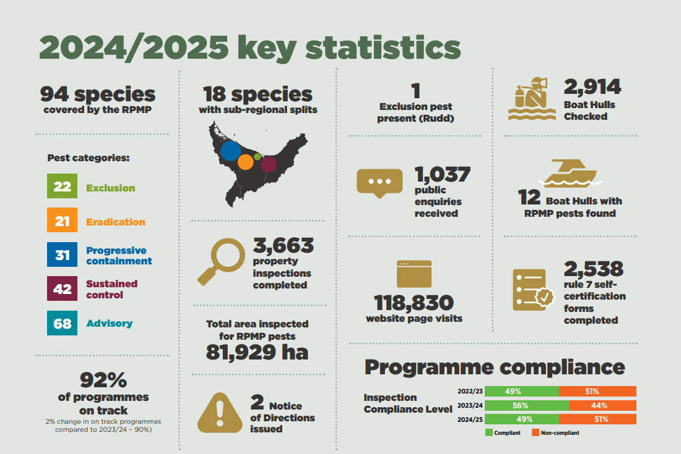

Slide 5
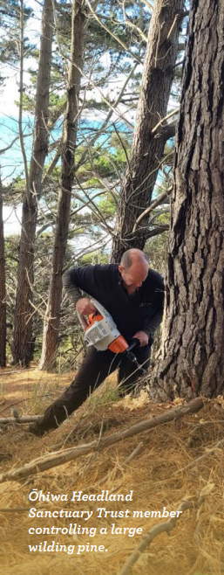
Key project - Wilding Pines
Objective: Protect high-value ecosystems and reduce wilding conifer spread.
2024/25 Results
3,188 ha treated
22,938 trees controlled
99% of trees controlled were Pinus contorta (Lodgepole Pine)
Significant protection of vulnerable Rangitāiki frost-flat ecosystems
Programme tracking well towards RPMP objectives
Funding Source
Collaborative programme between: National Wilding Conifer Control Programme (Biosecurity New Zealand) and
Bay of Plenty Regional Council
Department of Conservation
Hawke's Bay Regional Council
BOPRC directly invested $95,782 in 2024/25, leveraging substantial national programme investment and partner funding.
Notes:
Both wallabies and wilding conifers are landscape-scale biosecurity threats that can dramatically alter ecosystems, reduce biodiversity, and impact productive land across the Bay of Plenty and neighbouring regions.

Slide 6
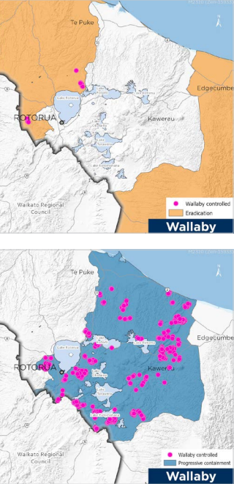
Key Project - Wallabies
Objective: Eliminate outlier populations and contain established populations.
2024/25 Results
23,050 ha surveyed in eradication areas
2,350 km of detector dog surveillance
280 cameras deployed
15 wallabies controlled in eradication areas
1,988 wallabies controlled within the containment zone
Six outlier populations believed eliminated and several others in proof-of-absence monitoring
Funding Source
Jointly funded through the Tipu Mātoro National Wallaby Eradication Programme
Bay of Plenty Regional Council delivers the programme regionally with funding support from Biosecurity New Zealand and national programme partners.
Total programme expenditure in 2024/25 was approximately $2.05M, with revenue of $2.07M, reflecting strong external investment into the region.
Notes:
These programmes demonstrate how strategic regional investment, combined with significant national co-funding, is delivering landscape-scale biosecurity outcomes that would be difficult for any one organization to achieve alone

Slide 7
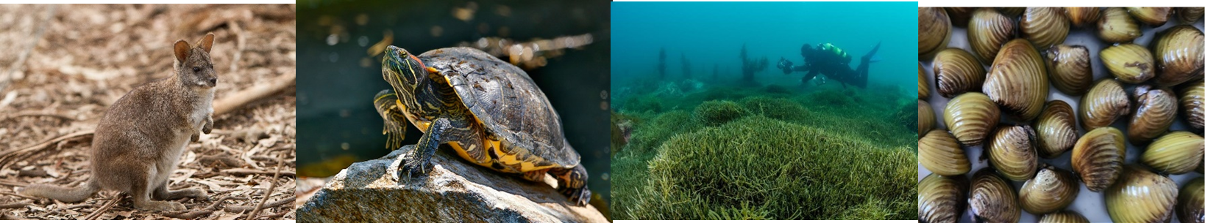
Emerging Threats
Corbicula (Freshwater Gold Clam)
Corbicula is an invasive freshwater clam recently detected in the Waikato River system.
It spreads easily via boats, trailers, fishing gear and watercraft.
Dense populations can alter freshwater ecosystems, impact infrastructure and outcompete native species
Exotic Caulerpa
Exotic Caulerpa is a highly invasive marine seaweed capable of rapidly colonising coastal habitats.
It can smother native marine ecosystems, alter habitats and impact recreational and commercial activities.
Due to its invasive potential, Exotic Caulerpa was added to the amended RPMP as an Exclusion pest in June 2025

Slide 8
Caulerpa – BOPRC response
Public awareness campaign funded by MPI during 2025/26.
Signage, advertising, education and community engagement.
Summer surveillance activities and over 1,000 public awareness surveys completed.
Ongoing readiness planning with national partners
Surveillance in neighboring regions

Slide 9
Corbicula – BOPRC response
Strong partnership with Biosecurity New Zealand, Te Arawa Lakes Trust, Rotorua Lakes Council and iwi/hapu.
Check, Clean, Dry and self-certification campaigns. (Rule 7 compliance)
Automated access control system installed at Lake Ōkataina to reduce the risk of spread into high-value lakes.
Ongoing surveillance, monitoring and public awareness activities
Notes:
Following the discovery of Corbicula (freshwater gold clam) in the Waikato River, BOPRC has used Rule 7 as a key tool to reduce the risk of spread into Bay of Plenty lakes. Self-certification at boat ramps helps ensure users have inspected and cleaned their vessels and equipment before entering waterways

Slide 10
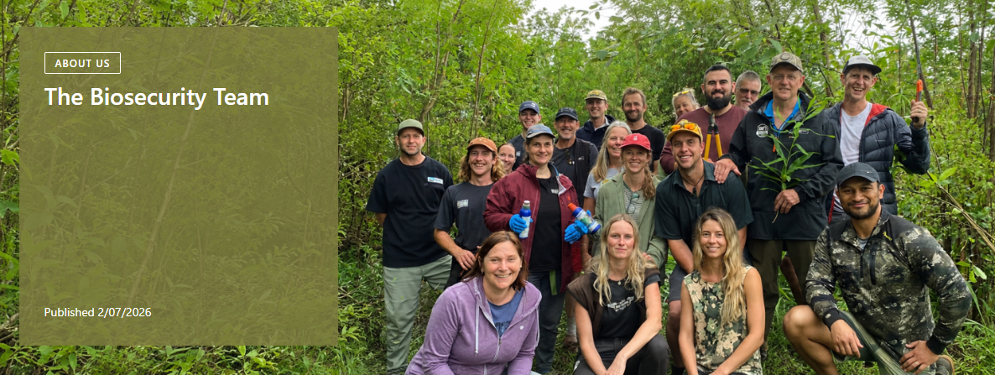
Thanks for your time!

